Slide 1
Final Presentation SAR Image Classification Using Deep Learning
Student: Avichay Ashur
Supervisor: Dr. Meir Bar zohar
Semester: Spring, 2024
Date: 30/07/2024

Slide 2
Outline
Project goal, background and literature survey
Chosen Solution and Results
Conclusions and Future work

Slide 3
Outline
Project goal, background and literature survey
Chosen Solution and Results
Conclusions and Future work

Slide 4
Project Goals
Learn and understand the principles of Synthetic Aperture Radar.
Understand and reproduce the current implementations for classifying SAR images.
Try to improve the performances of current networks on MSTAR [1] dataset.

Slide 5
Project Goals
Training:
Inference:
Data Augmentation
Augmented Dataset
Classifier network
Trained Classifier network
MSTAR DB
Training
Trained Classifier Network
Data Sample
Prediction

Slide 6
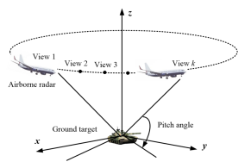
Background
Synthetic Aperture Radar (SAR) is a form of radar that is used to create 2D/3D images of objects.
SAR basic principles [2] :
Radar Signal Transmission: The SAR sends out pulses of radio waves (100kHz – 10GHz).
Echo Collection: The radar collects the echoes reflected from the ground target.
Data Integration: The radar integrates the received signals over time and space.
Signal processing: Advanced signal processing techniques used to create a final image with enhanced resolution.
SAR image processing require knowing the following:
Target Azimuth: Pitch Angle.
Flight Altitude: Z Height.
Flying Speed: Direction and Amplitude.

Slide 7
Background – SAR Pros/Cons
SAR Pros:
Can be mounted on a moving platform such as aircraft or spacecraft.
Capable of generating high resolution images.
Independent* of weather, can work during the day and the night.
Resolution doesn’t depend on flight altitude [2].
SAR Cons:
Takes long time (minutes to hours) to generate a single image, each image require several radar echoes to be collected over time.
Image depend on environmental conditions – different reflection coefficient.
Need to know moving speed, height and target location.
Only works on static targets.
Very difficult to visual interpretate without specialized training – Project Goal To Improve this issue
High computational requirements for data processing
*Heavy rain can degrade SAR image quality due to increased signal attenuation and scattering.

Slide 8
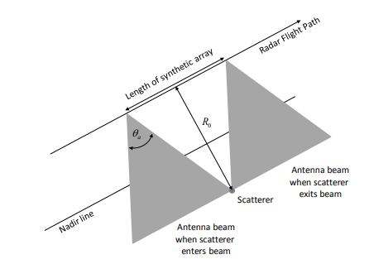
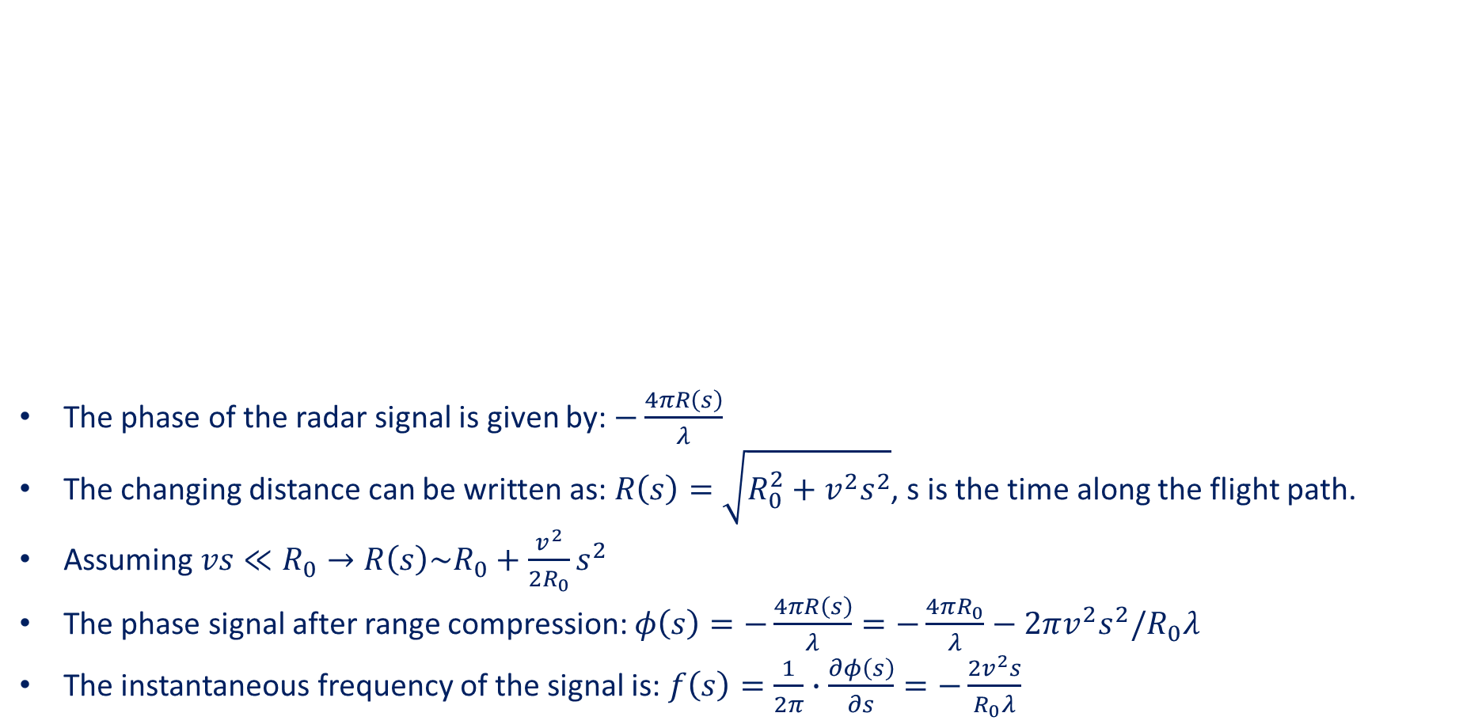
Background – Resolution
The phase of the radar signal is given by: $−\frac{4πR\left(s\right)}{λ}$
The changing distance can be written as:$R\left(s\right)=\sqrt{R_{0}^{2}+v^{2}s^{2}}$, s is the time along the flight path.
Assuming $vs≪R_{0}→R\left(s\right)\sim R_{0}+\frac{v^{2}}{2R_{0}}s^{2}$
The phase signal after range compression: $φ\left(s\right)=−\frac{4πR\left(s\right)}{λ}=−\frac{4πR_{0}}{λ}−2πv^{2}s^{2}/R_{0}λ$
The instantaneous frequency of the signal is: $f\left(s\right)=\frac{1}{2π}∙\frac{∂φ\left(s\right)}{∂s}=−\frac{2v^{2}s}{R_{0}λ}$

Slide 9
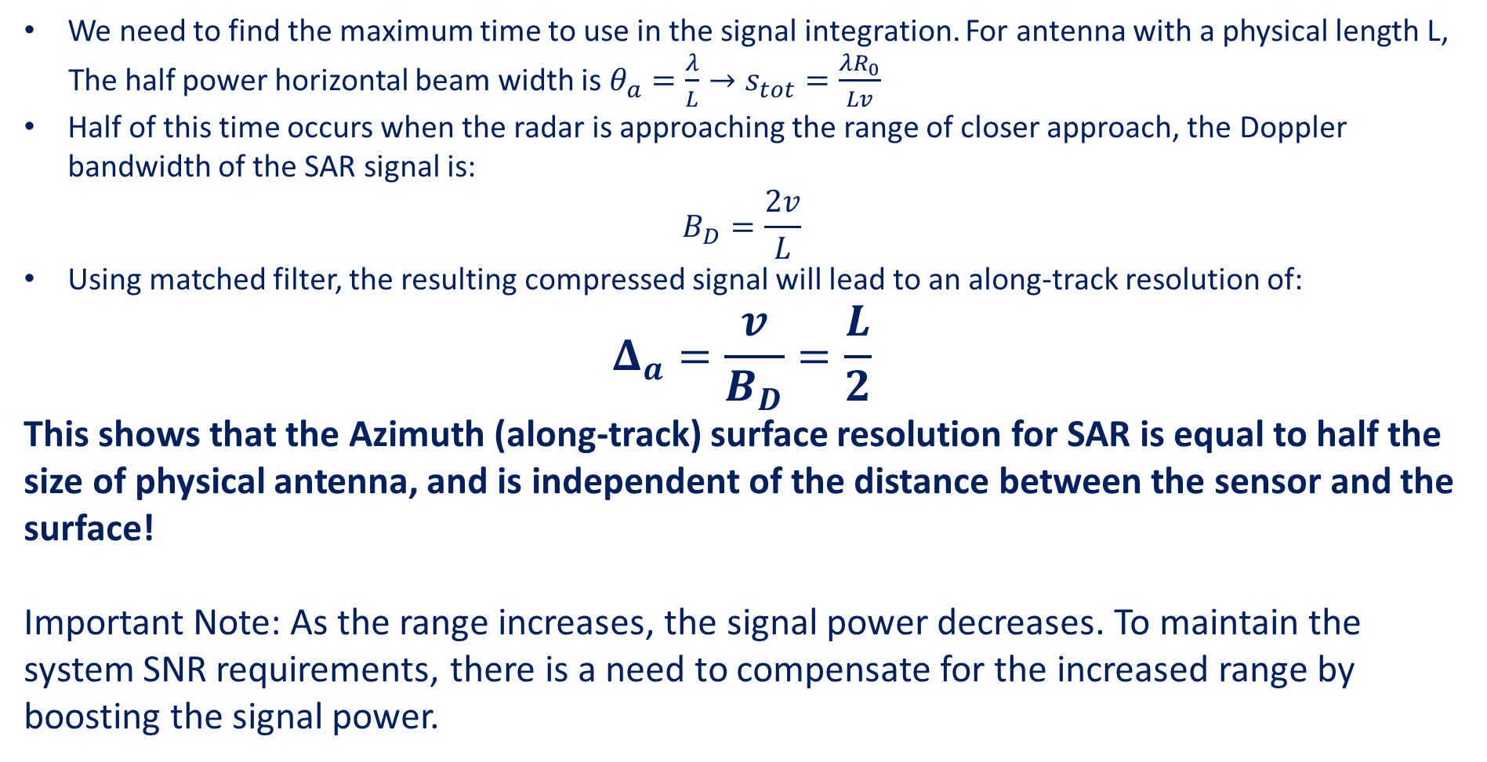
Background – Resolution
We need to find the maximum time to use in the signal integration. For antenna with a physical length L,
The half power horizontal beam width is $θ_{a}=\frac{λ}{L}→s_{tot}=\frac{λR_{0}}{Lv}$
Half of this time occurs when the radar is approaching the range of closer approach, the Doppler bandwidth of the SAR signal is:
$$B_{D}=\frac{2v}{L}$$
Using matched filter, the resulting compressed signal will lead to an along-track resolution of:
$$Δ_{a}=\frac{v}{B_{D}}=\frac{L}{2}$$
This shows that the Azimuth (along-track) surface resolution for SAR is equal to half the size of physical antenna, and is independent of the distance between the sensor and the surface!
Important Note: As the range increases, the signal power decreases. To maintain the system SNR requirements, there is a need to compensate for the increased range by boosting the signal power.

Slide 10
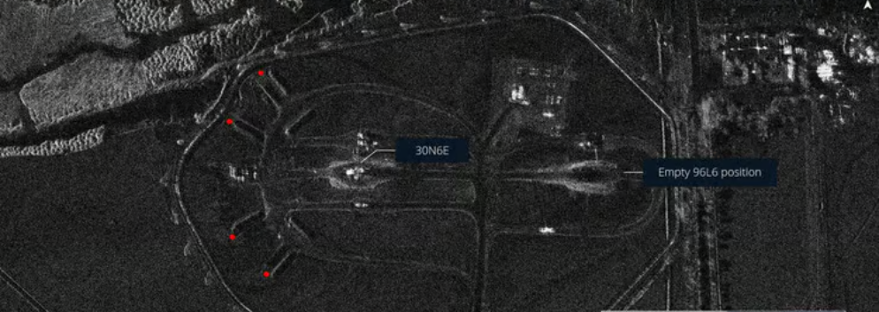
Background – SAR Image examples
SAR Image that went viral on April 2024, Damage of an attack that was done in Iran
Image from: Umbra space

Slide 11
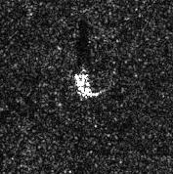
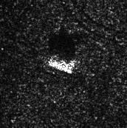
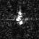
Background – SAR Image examples
Can you understand what u see in the image?
D7 (Tractor)
T62 (Tank)
SLICY (Building)

Slide 12
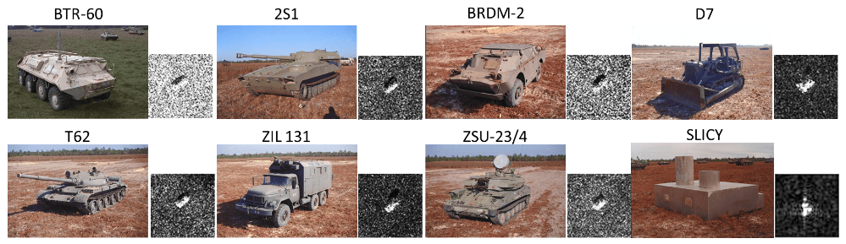
MSTAR Dataset
MSTAR
15° - Test
45° - Test
30° - Test
11 classes
17° - Train
4 classes
11 classes
5 classes
- 1 Class is "SLICY" – Usually excluded from the dataset – Resulting 10 class Total

Slide 13
MSTAR Dataset
Total* | ZIL131 | BMP2 | BTR60 | BTR70 | D7 | T62 | T72 | 2S1 | BRDM2 | ZSU_23_4 | SLICY | Deg
2,425 | 274 | 195 | 195 | 196 | 274 | 273 | 196 | 274 | 274 | 274 | 274 | 15° | Test
2,747 | 299 | 233 | 256 | 233 | 299 | 299 | 232 | 299 | 298 | 299 | 298 | 17° | Train
1,402 | 0 | 0 | 0 | 0 | 0 | 0 | 288 | 288 | 420 | 406 | 288 | 30° | Test
1,148 | 0 | 0 | 0 | 0 | 0 | 0 | 0 | 303 | 423 | 422 | 303 | 45° | Test
7,722 | 573 | 428 | 451 | 429 | 573 | 572 | 716 | 1,164 | 1,415 | 1,401 | 1,163 | Total
17 Deg is the biggest group
Some classes have less images (270/200)
Only 3/4 different classes in 30/45 Deg
*Total images without 'SLICY' class

Slide 14
MSTAR Dataset
SAR image classification is very complex duo to several reasons:
Small Dataset, Very expensive to generate new images.
Class imbalance.
Very subtle differences between some of the classes – makes it extremely difficult for humans to distinguish.
High variability in the target appearance.
Images suffer from Speckle noise, multiplicative noise, hard to model and to denoise.

Slide 15
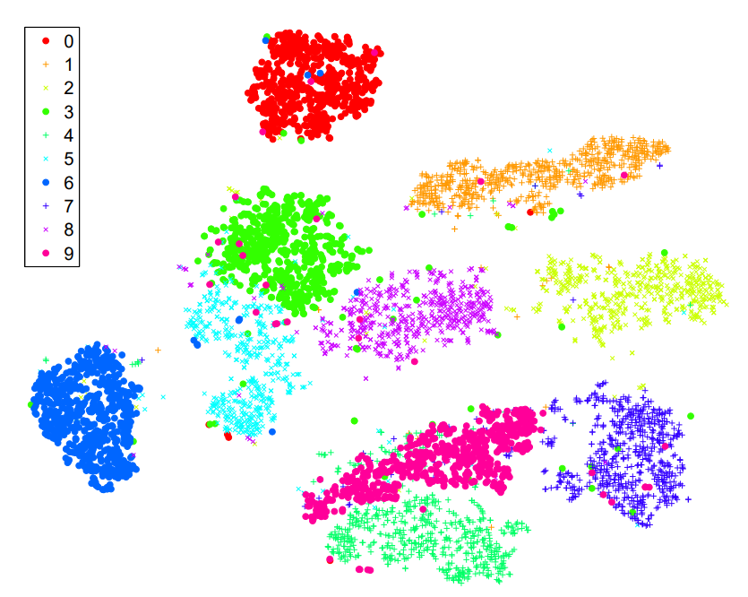
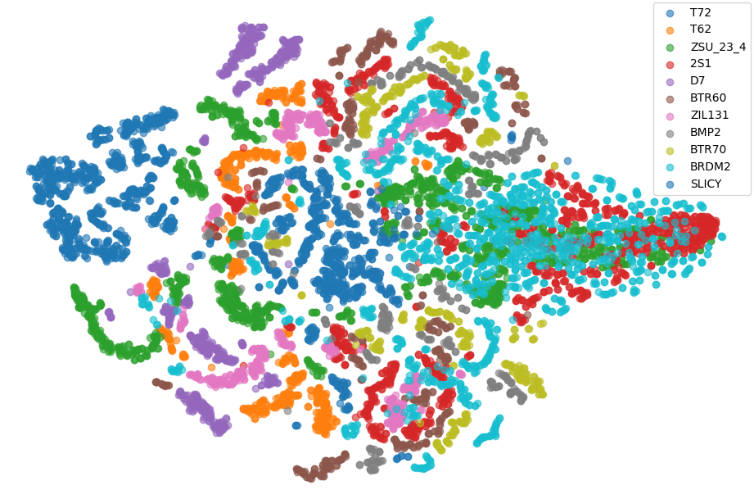
Data Visualization
MSTAR Dataset is a very complex dataset
t-SNE on MNIST dataset
t-SNE on MSTAR dataset – 11 Class
“SLICY” Class
Van der Maaten, L., & Hinton, G. (2008). "Visualizing Data using t-SNE." Journal of Machine Learning Research, 9, 2579-2605.

Slide 16
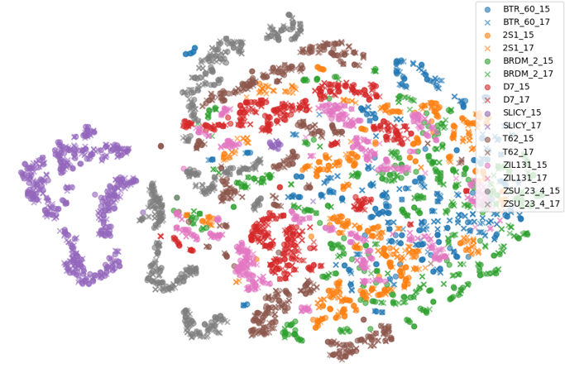
Data Visualization – 17 ° vs 15 °
“SLICY” Class

Slide 17
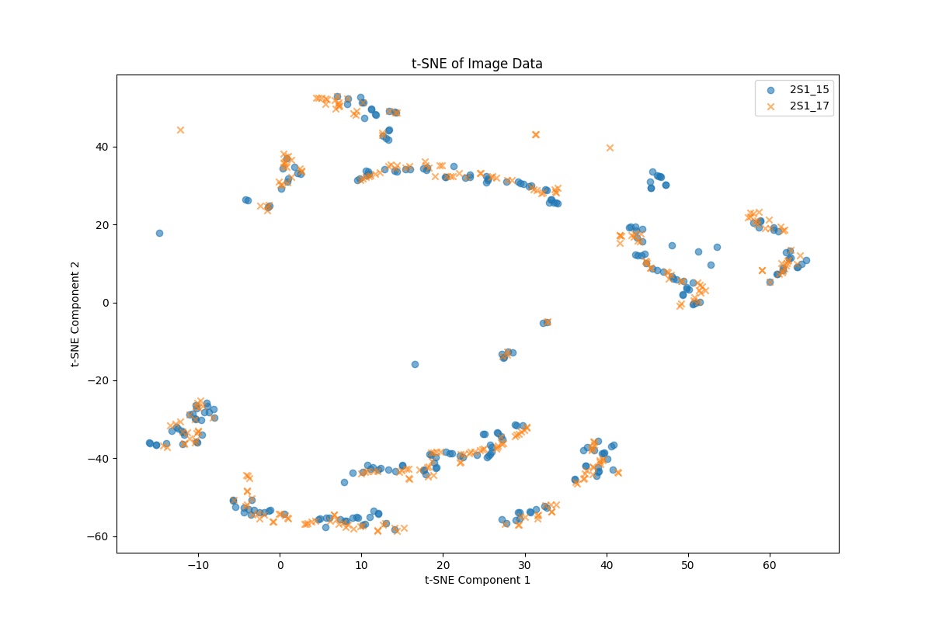
Data Visualization – 17 ° vs 15 ° - 2S1 class

Slide 18
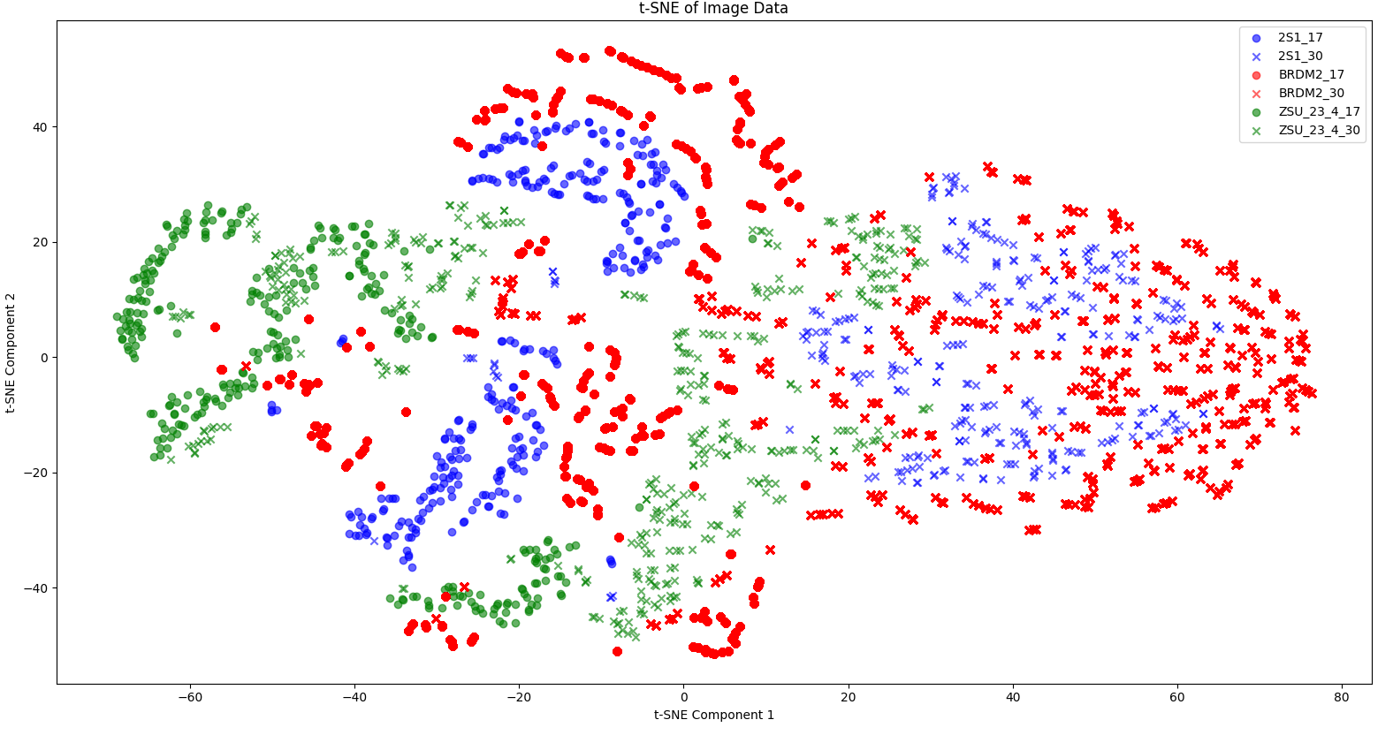
Data Visualization – 17 ° vs 30 °

Slide 19
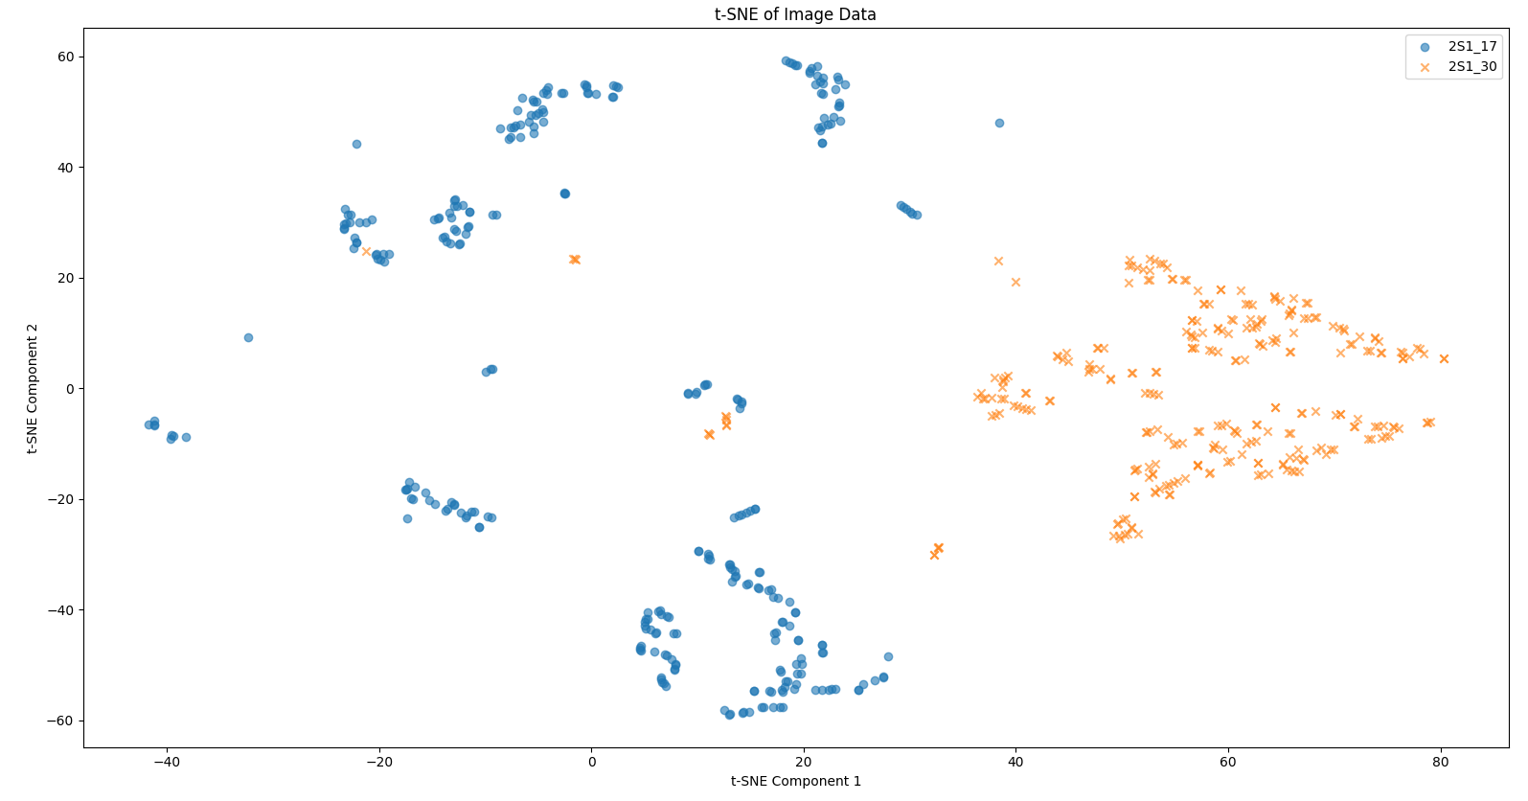
Data Visualization – 17 ° vs 30 °- 2S1 class

Slide 20
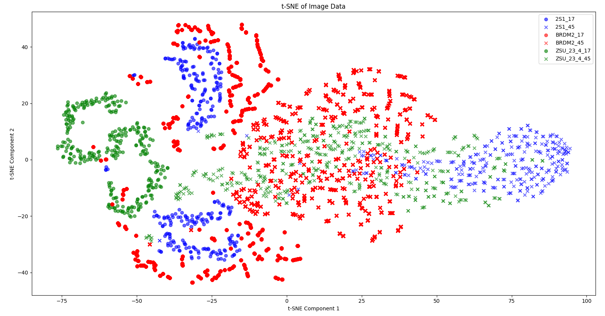
Data Visualization – 17 ° vs 45 °

Slide 21
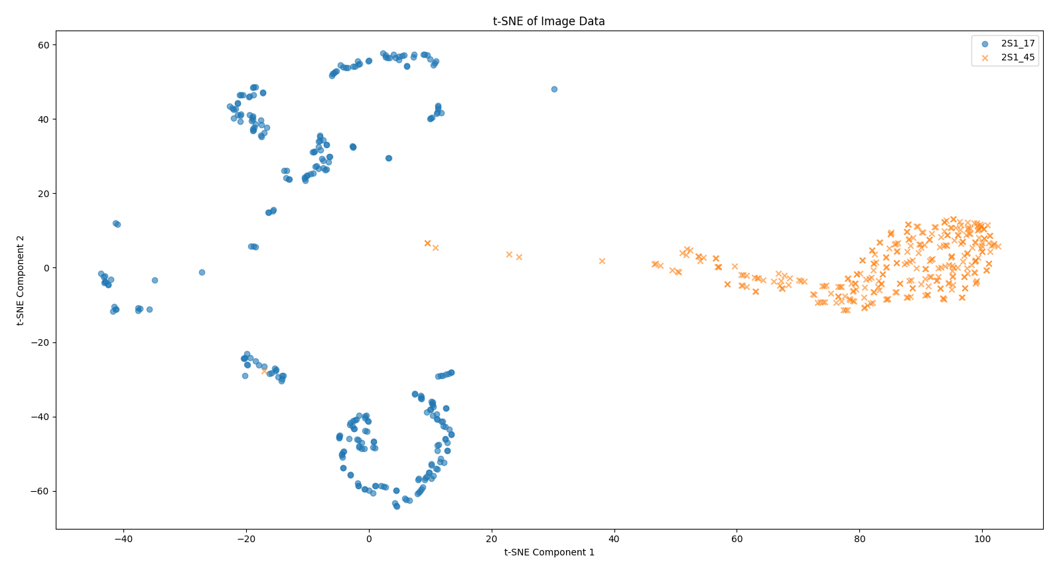
Data Visualization – 17 ° vs 45 °- 2S1 class

Slide 22
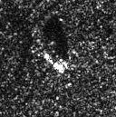
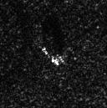
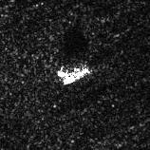
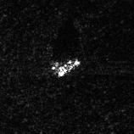
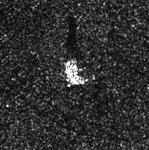
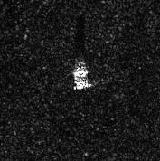
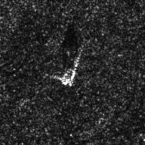
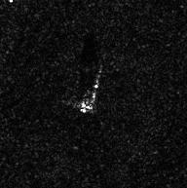
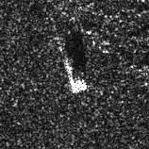
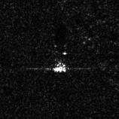
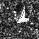
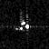
SAR Image Statistics
BRDM2
ZSU_23_4
D7
ZIL131
2S1
SLICY

Slide 23
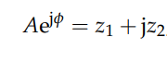
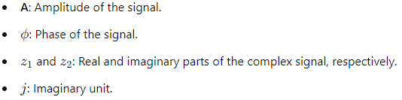
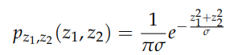
Literature Survey - SAR Image Statistics
[3]The image is obtained by superposition of incoherent scatter echoes, SAR echo can be represented:
The complex signal can be represented by Gaussian distributions with mean 0, the joint PDF is:

Slide 24
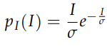
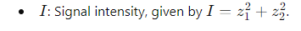
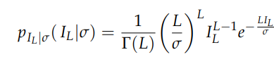
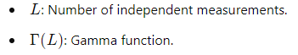
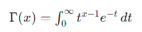
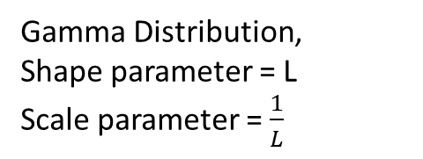
Literature Survey - SAR Image Statistics
The signal intensity obeys an exponential distributions, the PDF is:
In SAR system, L independent measurements are usually obtained for one observation. The PDF of the final measurement:
Gamma function:
Gamma Distribution, Shape parameter = L Scale parameter = $\frac{1}{L}$

Slide 25
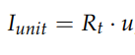
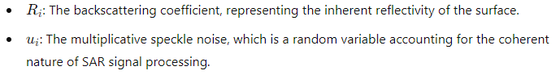
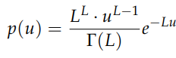
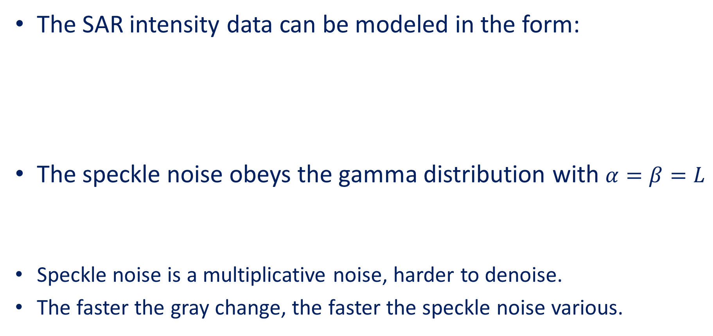
Literature Survey - SAR Image Statistics
The SAR intensity data can be modeled in the form:
The speckle noise obeys the gamma distribution with $α=β=L$
Speckle noise is a multiplicative noise, harder to denoise.
The faster the gray change, the faster the speckle noise various.

Slide 26
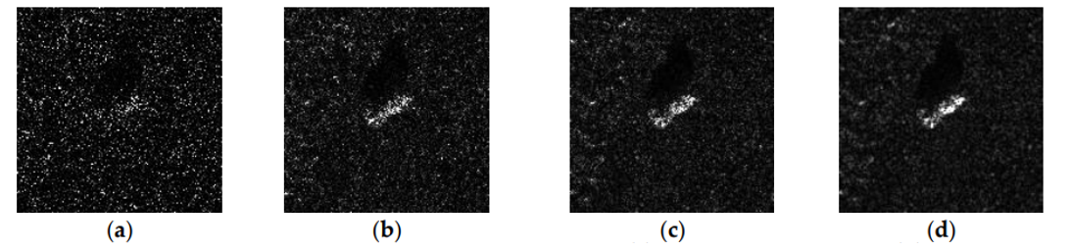
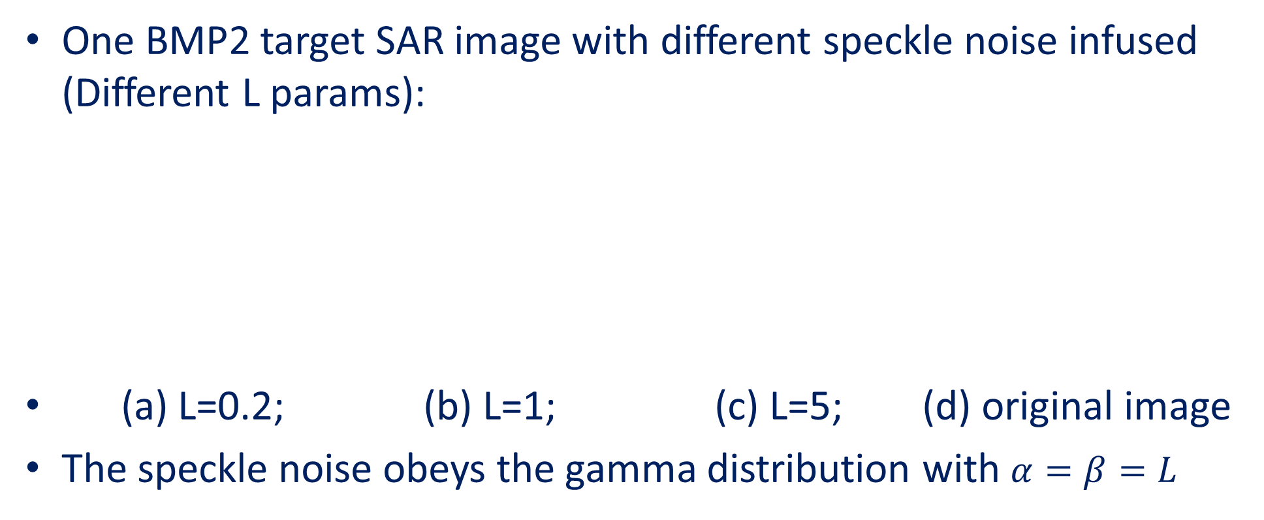
Literature Survey - Speckle Noise on MSTAR image
One BMP2 target SAR image with different speckle noise infused (Different L params):
(a) L=0.2; (b) L=1; (c) L=5; (d) original image
The speckle noise obeys the gamma distribution with $α=β=L$
Zheng, T.; Li, J.; Tian, H.; Wu, Q. The Process Analysis Method of SAR Target Recognition in Pre-Trained CNN Models. Sensors 2023, 23, 6461. https://doi.org/ 10.3390/s23146461

Slide 27
Outline
Project goal, background and literature survey
Chosen Solution and Results
Conclusions and Future work

Slide 28
Chosen Solution – Architectures overview
During the project we tested several solutions, classical and Deep Learning Networks. All Solutions were implemented in Python Code
Classical Methods:
KNN
KNN + Data Augmentation
Random Forest
Deep Neural Networks:
Matlab DL Network –Demo [4]
Resnet-18 [5]
LSTM [6]
LSTM Bidirectional [7]
Transformers [8]
AConvNet [9] (CNN Based network)
Ensemble-AConvNet - Ours

Slide 29
Matlab Demo for MSTAR
MATLAB have an example to show how to train a CNN to classify SAR targets.
The original MATLAB implementation[4] is based on the 8 class MSTAR dataset.
*Train = 0.8, Validation = 0.1, Test = 0.1
*This is not the standard data split in the literature

Slide 30
Matlab DL Architecture
Each Block contain:
Conv2d (K=kernel, O=output channels, P=padding=1)
ReLU Layer
Conv2d (K=kernel, O=output channels , P=padding=1)
Batch Norm (mean=0, variance =1)
ReLU Layer
Max Pooling (size 2, stride 2)
Input Image (128x128)
Block
K=3, O=32
Block
K=3, O=64
Block
K=3, O=128
Block
K=3, O=256
Conv2d
K=6, O=512, P=0
Dropout
P=0.5
FullyConnected
I=512, O=512
FullyConnected
I=512, O=8
SoftMax
128x128x1
64x64x32
32x32x64
16x16x128
8x8x256
1x1x512
1x1x512
512x512x1
512x8x1
1x8x1

Slide 31
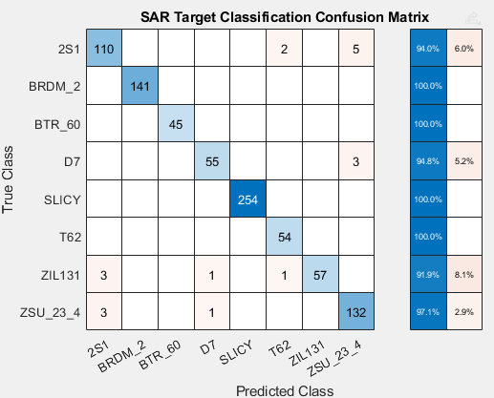
MATLAB Demo Results
8 Class All Data used Results:
9 | 8 | 7 | 6 | 5 | 4 | 3 | 2 | 1 | 0 | Run #
97.58 | 98.04 | 97.69 | 98.27 | 95.73 | 97.69 | 97.58 | 97.12 | 97.81 | 98.27 | Accuracy
Mean = 97.58, Variance=0.49
Problematic approach, very similar images within the same degree, therefore very high accuracy

Slide 32
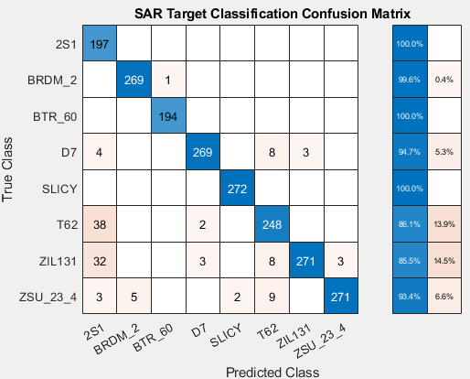
MATLAB Demo Results
8 Class – 17 Deg Train, 15 Deg Test
9 | 8 | 7 | 6 | 5 | 4 | 3 | 2 | 1 | 0 | Run #
90.75 | 91.81 | 91.13 | 89.11 | 90.20 | 92.56 | 89.39 | 91.81 | 90.27 | 88.11 | Accuracy
Mean = 90.51, Variance=2.59

Slide 33
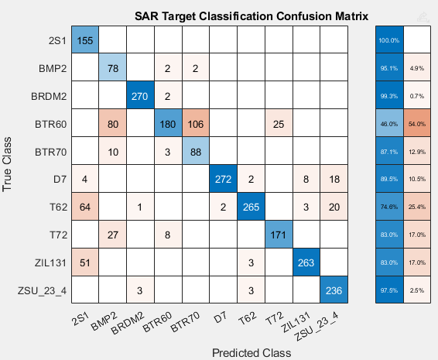
MATLAB Demo Results
10 Class – 17 Deg Train, 15 Deg Test
9 | 8 | 7 | 6 | 5 | 4 | 3 | 2 | 1 | 0 | Run #
83.01 | 86.97 | 85.98 | 74.39 | 80.41 | 76.12 | 82.02 | 88.58 | 81.57 | 83.96 | Accuracy
Mean = 82.30, Variance=18.30

Slide 34
Data Augmentation
The dataset consists of 10 classes, including 2,747 training images and 2,425 test images. We aim to augment the data to enhance its diversity and improve model performance.
Main Augmentation Methods Tested:
Adding Noise
Image Rotation
Image Patching [9]

Slide 35
Matlab Network– Augmentation Results
Image Patching achieved the best results in improving the model performances, therefore we used that augmentation in our solution.
Accuracy | Data Augmentation
83.67% | No Augmentation
62.60% | Rotation
90.52% | Gaussian Noise – N(0,0.01)
96.21% | Image Patching

Slide 36
Image Patching Augmentation
Image Patching Steps:
Original Training set is 2,747
After Augmentation Training set is: 134,603
Crop 94x94 Center Patch
1 Image
Crop 88x88 Patch with Stride 1
49 Images
Calculate FFT And save Phase in 2nd channel
49 Data Generated: 49x2x88x88
Network
Image Sample Input
Train
Train
Resize 128x128
Crop 88x88 Center Patch
Calculate FFT And save Phase in 2nd channel
Data Sample processed:
2x88x88
Network
Test
Test

Slide 37
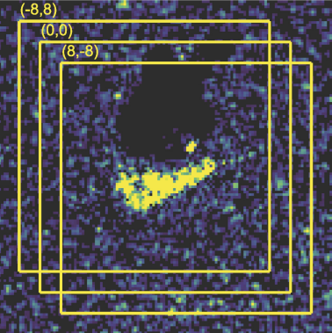
Image Patching Augmentation
We used (∆x, ∆y)-> ∆x ϵ[0,6], ∆y ϵ[0,6]
Illustration of translation (∆x, ∆y)
H. Furukawa, "Deep Learning for Target Classification from SAR Imagery: Data Augmentation and Translation Invariance," arXiv preprint arXiv:1708.07920, 2017.

Slide 38
Chosen Solution - AConvNet Architecture
AConvNet[9] is built from 5 CNN Layers + 3 Max Pool Layers.
300k Params | 1.16MB memory size.
All Max Pool layers are 2x2.
All Activations are ReLU, beside the final output – Softmax.
Dropout p=0.5
Input Image (88x88x2)
Conv2d + Max Pool
K=5, O=16, P=0
Conv2d + Max Pool
K=5, O=32, P=0
Conv2d + Max Pool
K=6, O=64, P=0
Conv2d
K=3, O=10, P=0
Conv2d
K=5, O=128, P=0
88x88x2
42x42x16
19x19x32
1x1x10
7x7x64
3x3x128
Original Hyper Parameters:
Batch Size = 100, Epochs = 100, Momentum = 0.9, Optimizer = ADAM, weight decay = 4e-3,
Learning Rate = 1e-3, Learning Rate step=[50], Learning Rate decay=0.1.

Slide 39
Chosen Solution – Ensemble AConvNet
Our solution is – Ensemble AconvNet.
We trained the network 4 times and perform Majority vote during inference of the models to select the class prediction.
In case of a tie, lower class number prediction chosen.
AConvNet
AConvNet
Sample Input
Majority Vote
Class Prediction
Image Input
Class Predictions
AConvNet
AConvNet

Slide 40
Results - 17 °vs 15 °
Size [MB] | Accuracy | Network
14.37 | 70.72 | Random Forest [10]
16.9 | 90.98 | KNN [11]
4141 | 92.02 | KNN [11] – 49 x Patches [14]
7.07 | 92.37 | Matlab Network [4]
3.4 | 93.81 | 1 layer Transformer [8]
5.8 | 94.31 | 2 layers Transformer [8]
0.301 | 97.4 | SSR Network [12]
3.91 | 97.7 | 1 layer Bidirectional LSTM [7]
254 | 97.91 | VGG16 [13]
43.2 | 98.1 | 2 layers Bidirectional LSTM [7]
22.7 | 98.47 | 2 Layer LSTM [6]
3.7 | 99.05 | 1 Layer LSTM [6]
1.16 | 99.1 | AConvNet - Random Patches [9]
1.16 | 99.34 | AConvNet – 49 x Patches [14]
44.5 | 99.56 | Resnet-18 – 81 x Patches [5]
4.64 | 99.71 | Ensemble AConvNet - OURS
Yellow = Classical Method, Blue = Deep Learning Architecture, Green =AConvNet Based Architecture, Brown = Our solution.

Slide 41
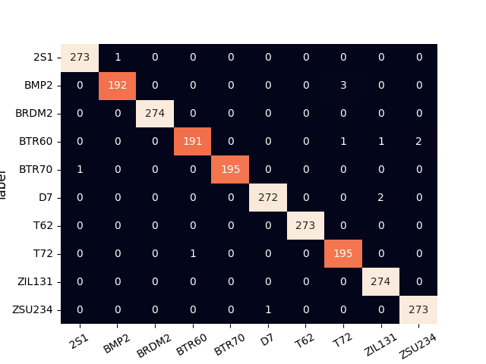




Results
Base Models – 99.42% Acc
Ensemble Prediction 99.71% Accuracy

Slide 42
Results – 17 ° vs 30 °
Source | Size [MB] | Accuracy | N class | Percentage of Data | Network
- | 1.16 | 56.39 | 4 | 10% | AConvNet
Link | 0.301 | 90.8 | 3 | 10% | W. Liang’s Network [10]
Link | 1.16 | 92.22 | 4 | 100% | AConvNet
- | 4.54 | 93.22 | 4 | 100% | Ensemble AConvNet
- | 1.16 | 95.6 | 3 | 100% | AConvNet
- | 4.54 | 96.12 | 3 | 100% | Ensemble AConvNet
Link | 0.301 | 98.9 | 3 | 100% | W. Liang’s Network [10]

Slide 43
Outline
Project goal, background and literature survey
Chosen Solution and Results
Conclusions and Future work

Slide 44
Conclusion
In this project, we successfully enhanced the current results on the MSTAR dataset.
Our chosen solution not only improved the accuracy but also reduced the network’s weight by 90% of the previous best-performing network.
We explored various approaches, including classical and deep learning methods, throughout our research, and compared their accuracies.

Slide 45
Future Work
Collaborate with Military Industries for SAR Data: Explore partnerships with military industries to acquire more SAR images. This collaboration aims to enhance the dataset and make it more relevant to modern times.
Leverage Small Dataset Learning: Based on W. Liang et al[10], utilize the existing dataset and other available datasets to investigate new regulations methods and architectures, focusing on effectively learning over small portions of datasets. Aiming to improve performances and generalization in limited data scenarios.

Slide 46
References
[1] MSTAR Dataset. Air Force Research Laboratory. Retrieved from https://www.sdms.afrl.af.mil/index.php?collection=mstar
[2] J. van Zyl, Y. Kim, "Synthetic Aperture Radar (SAR) Imaging Basics," 10.1002/9781118116104.ch1, 2011.
[3] T. Zheng, J. Li, H. Tian, Q. Wu, "The Process Analysis Method of SAR Target Recognition in Pre-Trained CNN Models," Sensors, vol. 23, no. 23, pp. 6461, 2023. Available: https://doi.org/10.3390/s23146461.
[4] SAR Target Classification Using Deep Learning. MathWorks. Retrieved from https://www.mathworks.com/help/radar/ug/sar-target-classification-using-deep-learning.html
[5] H. Furukawa, "Deep Learning for Target Classification from SAR Imagery: Data Augmentation and Translation Invariance," arXiv preprint arXiv:1708.07920, 2017.
[6] Hochreiter, S., & Schmidhuber, J. (1997). Long Short-Term Memory. Neural Computation, 9(8), 1735-1780. doi:10.1162/neco.1997.9.8.1735.
[7] Schuster, M., & Paliwal, K. K. (1997). Bidirectional Recurrent Neural Networks. IEEE Transactions on Signal Processing, 45(11), 2673-2681. doi:10.1109/78.650093.

Slide 47
References
[8] Vaswani, A., Shazeer, N., Parmar, N., Uszkoreit, J., Jones, L., Gomez, A. N., Kaiser, Ł., & Polosukhin, I. (2017). Attention is All You Need. In Advances in Neural Information Processing Systems (NIPS), 30.
[9] S. Chen, H. Wang, F. Xu and Y. Q. Jin, "Target Classification Using the Deep Convolutional Networks for SAR Images," in IEEE Transactions on Geoscience and Remote Sensing, vol. 54, no. 8, pp. 4806-4817, Aug. 2016. doi:10.1109/TGRS.2016.2551720 http://ieeexplore.ieee.org/document/7460942/
[10] Breiman,L. (2001). Random forests. Machine Learning, 45(1), 5-32. https://doi.org/10.1023/A:1010933404324
[11] Cover, T. M., & Hart, P. E. (1967). Nearest neighbor pattern classification. IEEE Transactions on Information Theory, 13(1), 21-27. https://doi.org/10.1109/TIT.1967.1053964
[12] W. Liang, T. Zhang, W. Diao, X. Sun, L. Zhao, K. Fu, Y. Wu, "SAR Target Classification Based on Sample Spectral Regularization," Remote Sens., vol. 12, no. 12, pp. 3628, 2020. Available: https://doi.org/10.3390/rs12213628.
[13] A. Hasni, M. Hanifi, C. Anibou, M. Saidi, "Deep Learning for SAR Image Classification," 10.1007/978-3-030-29516-5_6, 2020.
[14] Park, J. (n.d.). AConvNet-pytorch. GitHub. https://github.com/jangsoopark/AConvNet-pytorch/tree/main

